Slide 1
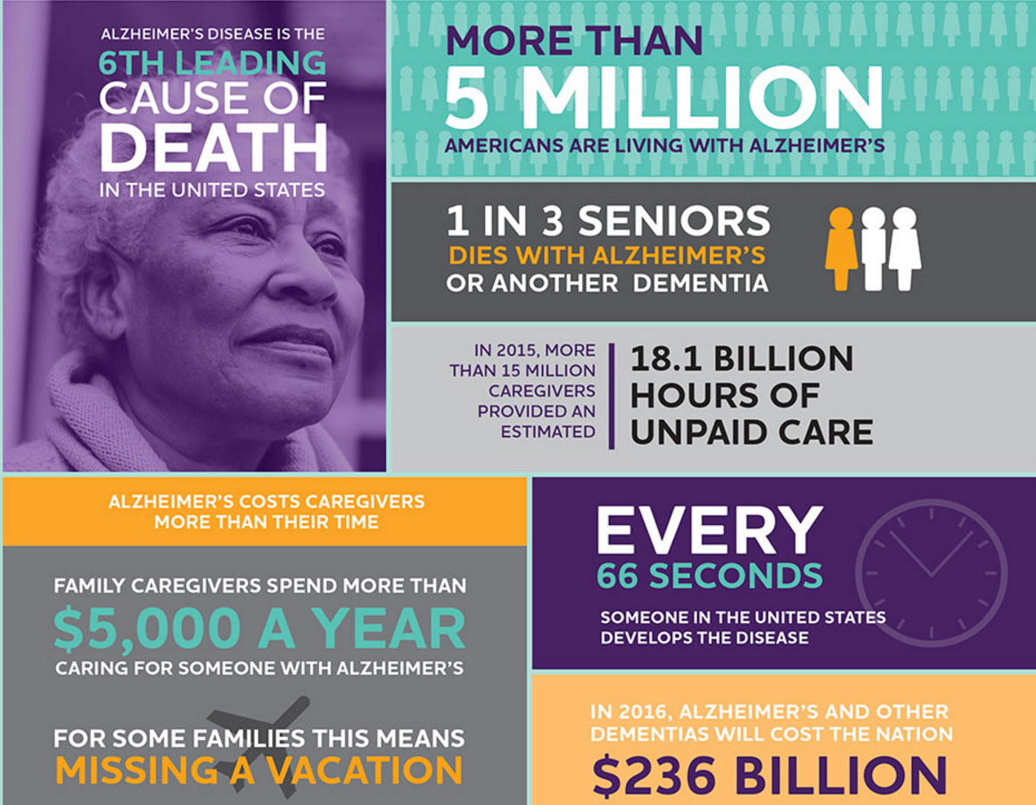
Genomic Variants Associated with Brain Atrophy Linked to Alzheimer’s disease
Ali Kirwen
Elliot Rossow
Joe Webb
Departments of Anthropology & Psychology
Department of Agronomy
Department of Food Science and Human Nutrition
aplovett5@iastate.edu
erossow@iastate.edu
jlwebb@iastate.edu

Slide 2
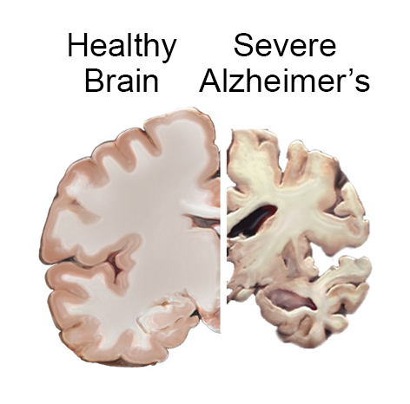
Alzheimer’s Disease (AD) Pathology
Healthy Brain
Alzheimer’s Brain
LaFerla, et al. Nature Reviews Neuroscience 2007

Slide 3
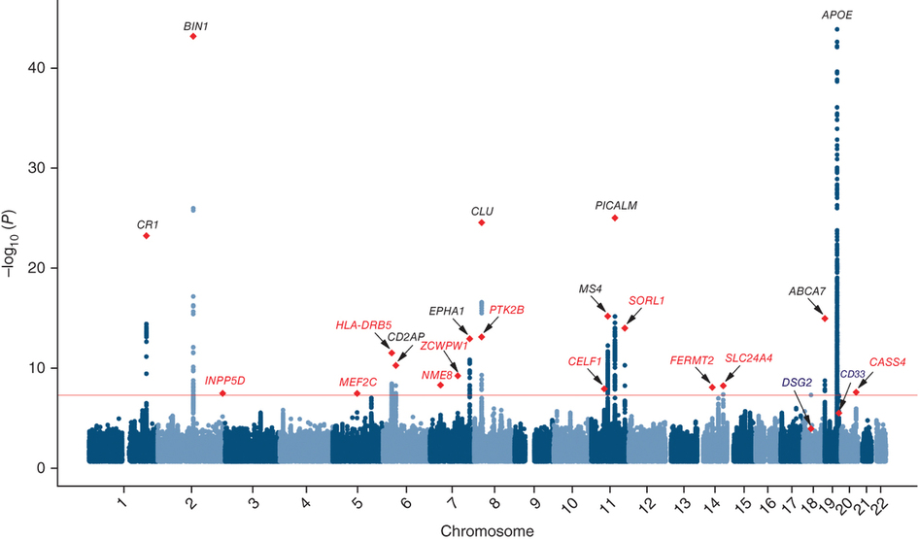
Lessons From Genomics
Nho, et al. Alzheimers & Dementia 2016

Slide 4
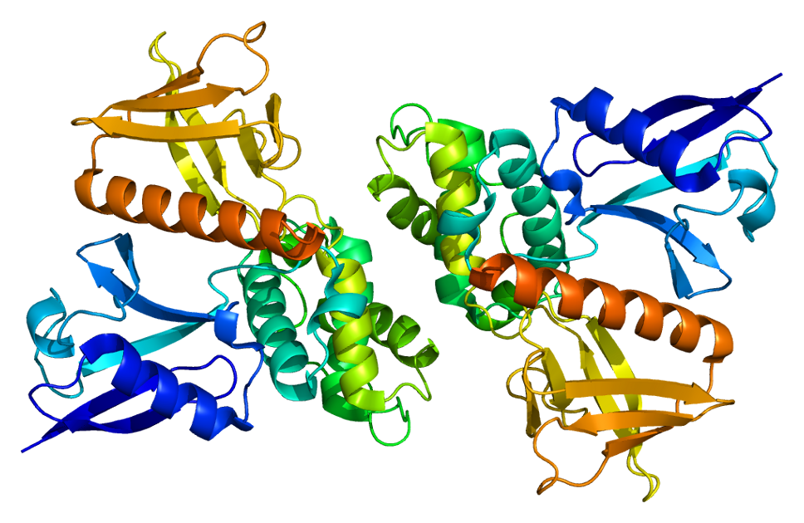
Background – FRMD6 & AD
Imaging genetics and genome-wide gene-based case-control association analysis have implicated FERM domain-containing protein 6 (FRMD6) in Alzheimer’s disease (AD)
FRMD6 is a protein on Chromosome 14 but relatively little is known about its function
Pathway analyses demonstrates that FRMD6 could regulate cytoskeletal architecture which is dysregulated in AD
Potkin et al. 2009, Hong et al. 2012

Slide 5

Study Design
Discovery whole-genome sequencing in 2586 Swedes - 615 AD cases and 1668 controls
Replication whole-genome sequencing in independent cohorts
Overall Meta Analysis – 4259 cases and 8284 controls
Follow up analyses examining brain surface area and putative AD biomarkers
Nho, et al. Alzheimers & Dementia 2016

Slide 6
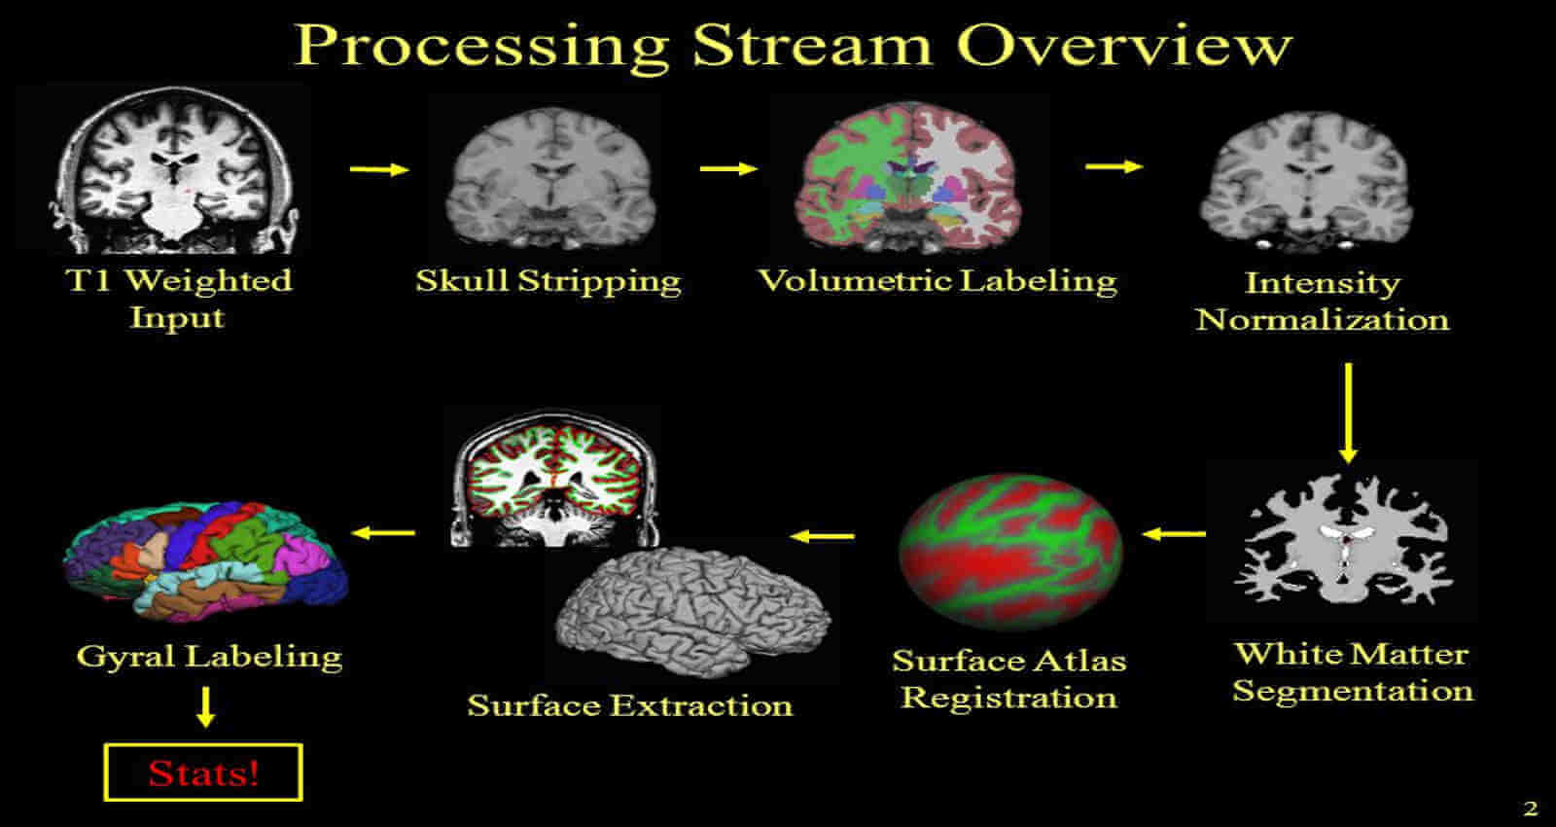



Data Access & Generation
Only a subset of these data were publicly available from the ADNI database (N=756) where only 404 had baseline volumetric MRI scans
Extract Surface Area using Freesurfer 6.0.0 from MRI scan
Extract SNPs after implementing a Pipeline using Shapeit/Impute2

Slide 7
Genomic Data Processing Pipeline
Download Reference Sets
5 minutes
Raw Genotypes
Create Input Files
Step 1 – Collect raw data
Step 2 – Quality Control
Step 3 – download reference genomes
Step 4 – Create new files
Step 5 – LiftOver to newest genome build
Step 6 – Prephase with Shapeit
Step 7 – Imputation with Impute2
Step 8 – Examine Imputed Genotypes
15 minutes
Quality Control
10 minutes
LiftOver to HG19
Prephasing with Shapeit
76 hours
Imputation using Impute2
165 hours
Imputed Genotypes
van Leeuwen, et al. Nature 2015

Slide 8
Analyses
Authors Reported 4 major GLMs having been run:
SNP * age
SNP * gender
SNP * years of education
SNP * intracranial volume (ICV)
SNP * MRI field strength

Slide 9
Results
SNP *Age
t = .732, p < .465
SNP * Sex
t = 11.92, p <2e-16 ***
SNP * Education
t = 3.084, p < 0.00212 **
SNP * intracranial volume (ICV)
SNP * MRI field strength
Signif. codes: 0 ‘***’ 0.001 ‘**’ 0.01 ‘*’ 0.05 ‘.’ 0.1 ‘ ’ 1

Slide 10
Results
Temporal Surface Area * Sex + Age + Education
Sex
t = 11.451, p <2e-16 ***
Age
t = -0.068, p <.946
Education
t = 1.052, p <.293
Signif. codes: 0 ‘***’ 0.001 ‘**’ 0.01 ‘*’ 0.05 ‘.’ 0.1 ‘ ’ 1

Slide 11
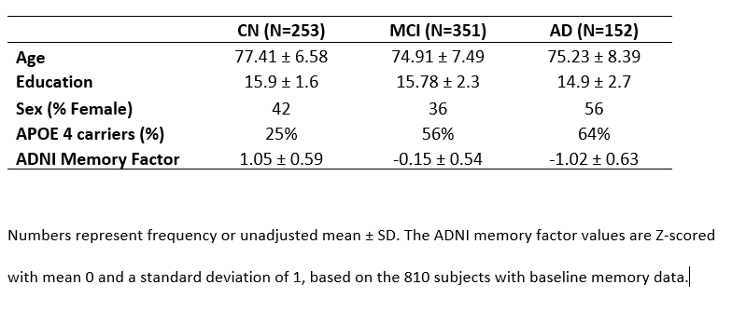
Clinical & Demographic Data

Slide 12
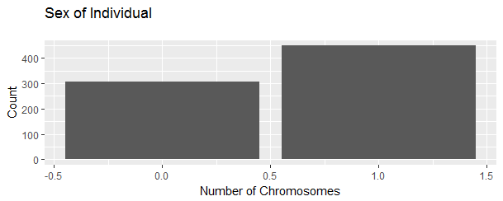
Female
Male

Slide 13
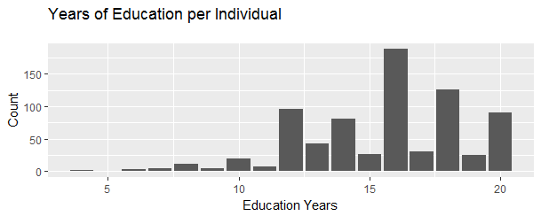
Graphs

Slide 14
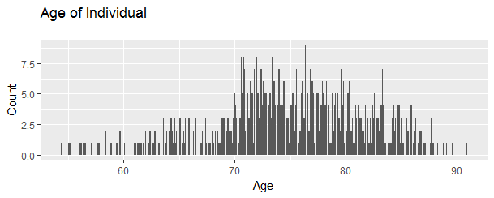

Slide 15
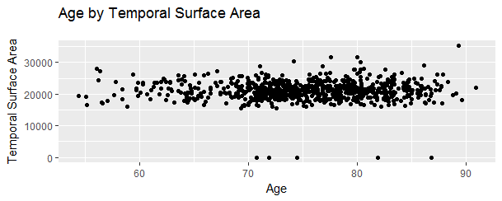

Slide 16
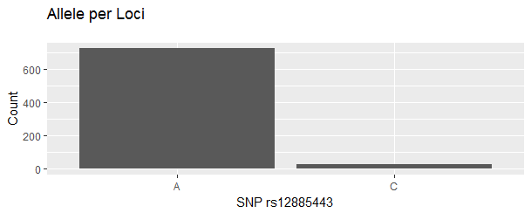
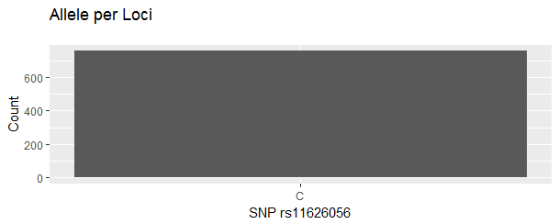
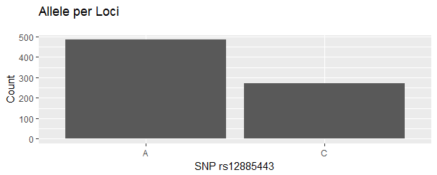
Minor vs Major Allele

Slide 17
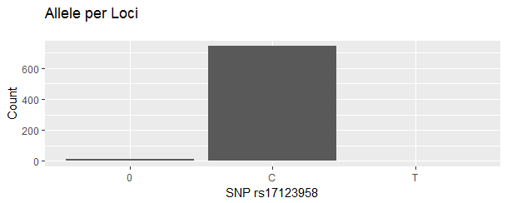

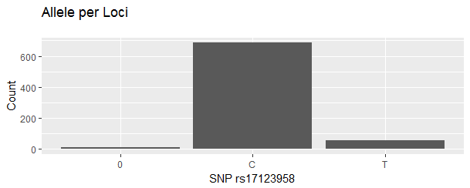
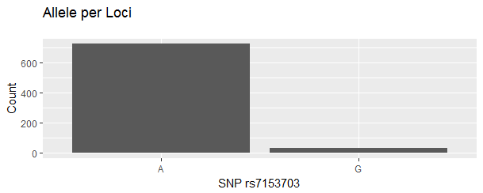
Graphs

Slide 18

Conclusion and Future Directions
FRMD6 variants may represent a substantial risk factor for developing AD.
The FRMD6 mutations may affect cellular architecture underlying neuronal death
Future studies should stimulate FRMD6 function to assess effects on other AD biomarkers and outcomes.
Take Home Message – Aggregating Big Data may serve as a useful tool to provide new insight into the underlying mechanisms in AD.
18 people developed Alzheimer’s disease during this presentation. Our clock is ticking.
Guerreiro, et al. N Engl J Med 2013

Slide 19

Thank you for your time and are there any questions?

